Slide 1
AD中 皮质铁和tau沉积的关系研究
汇报人：李睿

Slide 2
研究背景
Past in vitro and post-mortem studies have suggested there is a relationship between excessive iron deposition and the hallmarks of Alzheimer’s disease proteinopathy, namely amyloid-β plaques and neurofibrillary tangles.
Tau蛋白高度磷酸化形成的神经原纤维缠结（NFTs）是AD的典型病理表现之一
而铁在衰老中起着矛盾的作用：一方面，铁是机体内重要的微量元素, 广泛存在于脑组织, 参与多巴胺等神经递质的合成、髓磷脂合成、神经髓鞘的合成和发育等重要生理过程；另一方面，人脑中的铁含量与年龄呈现相关性，随年龄的增长而增高，而铁是一种活跃的氧化剂，它的过度积累参与了炎症发生、氧化应激等病生过程，提示存在着与年龄相关的铁稳态失衡
Notes:
过去的体外和尸检研究表明，铁的过度沉积与阿尔茨海默病病理蛋白的标志（即β样淀粉样斑块和神经纤维缠结）之间存在着关系。

Slide 3
研究背景
Recently, Ayton et al. (2019) carried out an ex vivo study suggesting an association between iron accumulation in the inferior temporal gyrus (ITG) and steeper rate of cognitive decline in subjects showing significant amyloid-b plaques and tau tangles
The authors found that the sites of increased iron content were non-overlapping with amyloid plaque formation, but that sites of increased iron content were spatially co-localized with areas of tau burden
An association between iron, as measured by an iron-sensitive MRI sequence (T2*), and tau accumulation was also found in a combined post-mortem MRI and histological study from Bulk et al. (2018b)
A possible relationship between iron accumulation and pathological tau aggregation are still lacking

Slide 4
研究背景
QSM是在磁敏感性加权成像（susceptibility weighted imaging，SWI）基础上发展起来的一种新型图像后处理技术，是对相位图进行拟合后，再进行相位解缠绕和背景场去除的处理得到局部组织场图，最后经过复杂的由场溯源的反演计算，得到定量磁化率分布图。QSM克服了对比度的取向依赖性和非局部性的缺点，更好地反映了组织成分的变化，可直接反映大脑的磁化率分布情况，可以提高由铁沉积引起的信号变化的灵敏度，目前被认为是测量铁沉积更为准确的方法
虽然 SWI 与 QSM 都以 GRE 序列为基础，两者都反映了组织间的磁敏感差异，但两者后处理方法不同。SWI 是将相位图与幅度图加权融合，得到的仅是磁敏感差异导致的相位变化的信息，是磁化率的半定量测量方法；而 QSM 通常是对相位图进行拟合后，再进行相位解缠绕和背景场去除的处理得到局部组织场图，最后经过复杂的由场溯源的反演计算，得到定量磁化率分布图，可计算每个体素的相对磁化率值。此外，QSM 克服了对比度的取向依赖性和非局部性的缺点，更好地反映了组织成分的变化

Slide 5
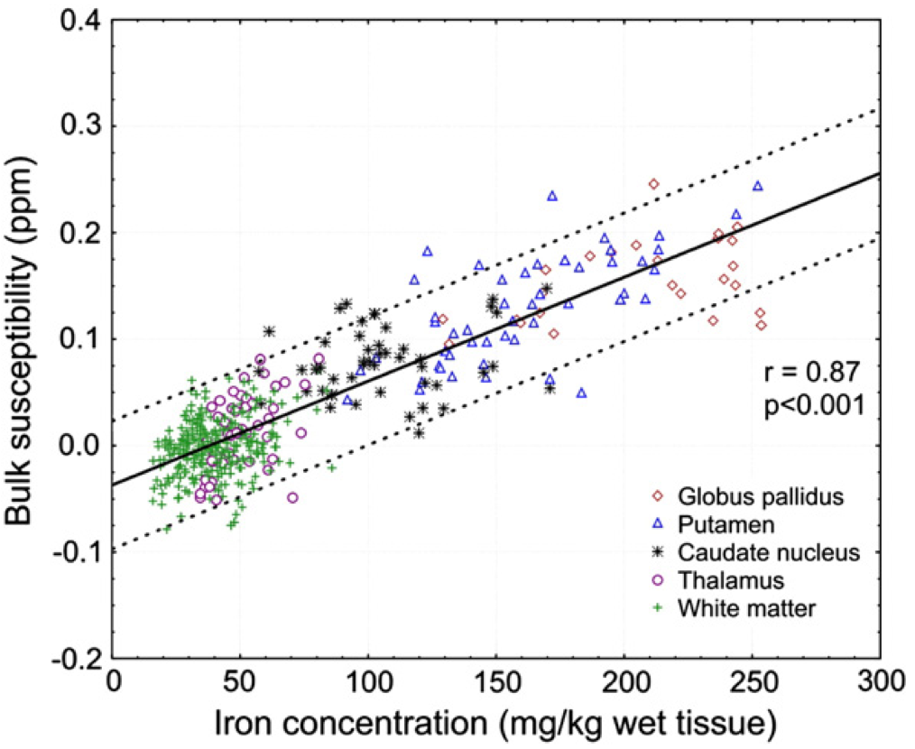
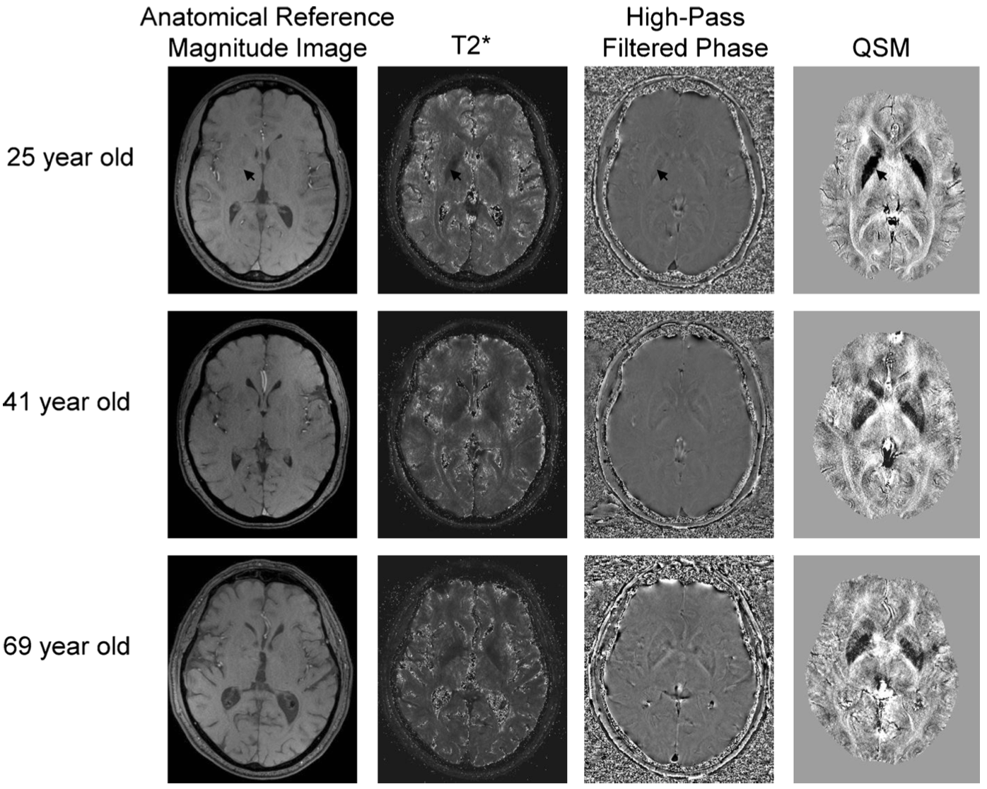
研究背景
深部灰质核团中磁化率与铁的浓度高度相关
化学测定的脑组织铁浓度和磁化率之间有很强的线性相关（r=0.84，p<0.001）
白质中相关系数要低得多（r=0.27，p<0.001）
(Langkammer et al. Neuroimage 2012;62:1593–1599)
(Daugherty et al. Neuropsychol Rev 2015;25:272–287)
Notes:
诸多研究证实深部灰质核团中磁化率与铁的浓度高度相关，QSM是一种有效定量铁的影像手段

Slide 6
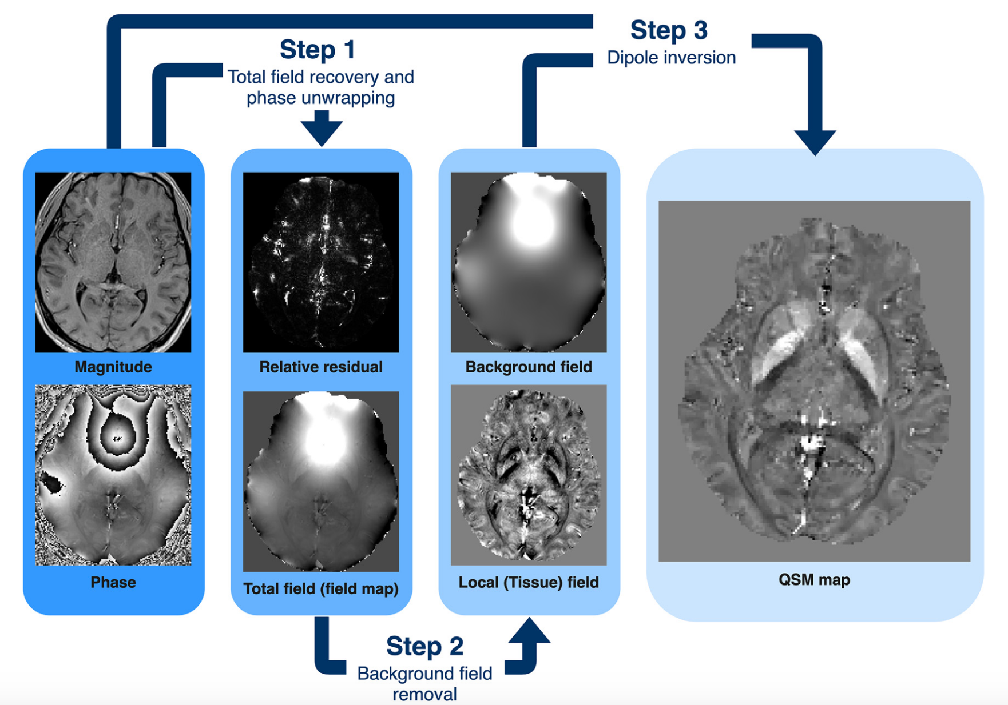
研究背景
QSM图重建：场图拟合（单回波不需要）、相位解缠 绕 、背景场去除和磁化率反演

Slide 7
研究目的
At the voxel-grey matter level and in a region of interest analysis focusing on the ITG, a region known to be severely affected by tau pathology in Alzheimer’s disease and commonly assessed with tau-PET
Investigated the possible mediation effect of iron content (as measured with QSM) on the link between tau aggregation and neuronal loss, the latter approximated by cortical thickness measurements from structural MRI
Notes:
在体素-灰质水平和ROI分析中，重点关注ITG，该脑区已知受到阿尔茨海默病中tau病理学的严重影响，通常用tau-PET评估。
研究铁含量（用QSM测量）对tau聚集和神经元丢失之间的可能中介效应，后者由结构性MRI的皮质厚度衡量。

Slide 8
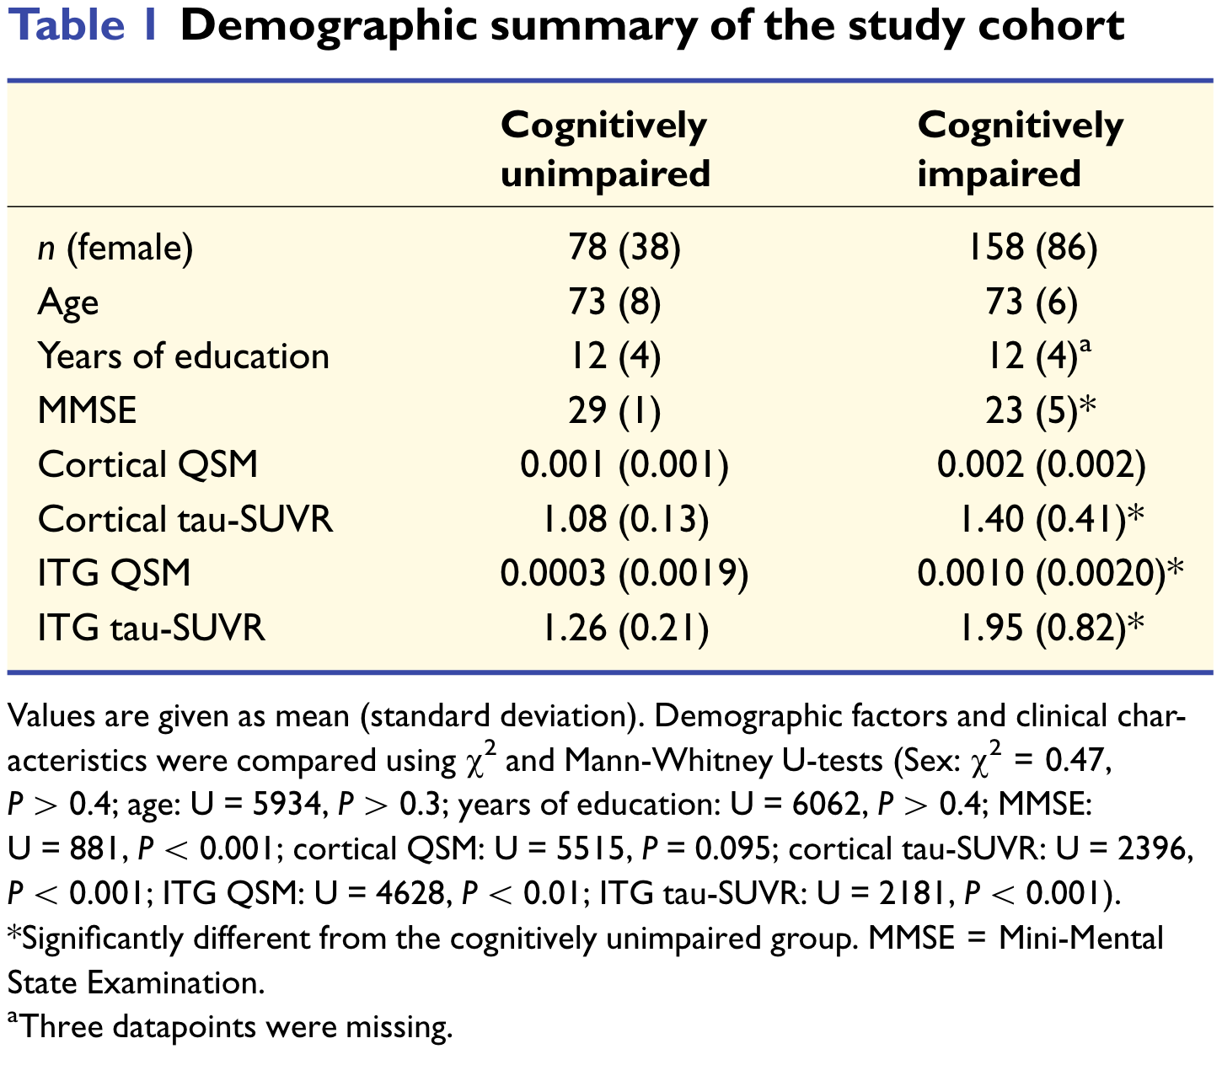
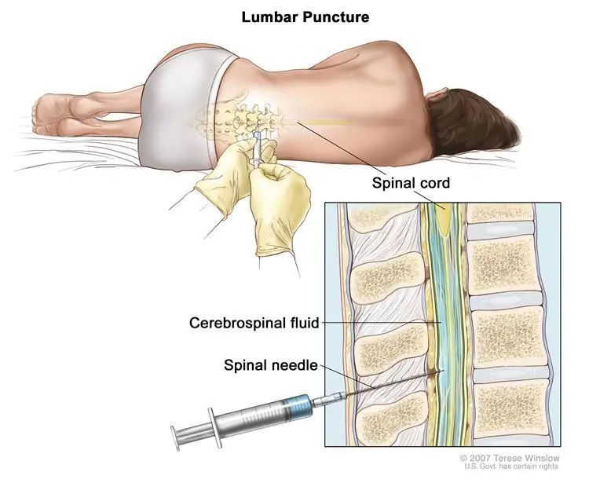
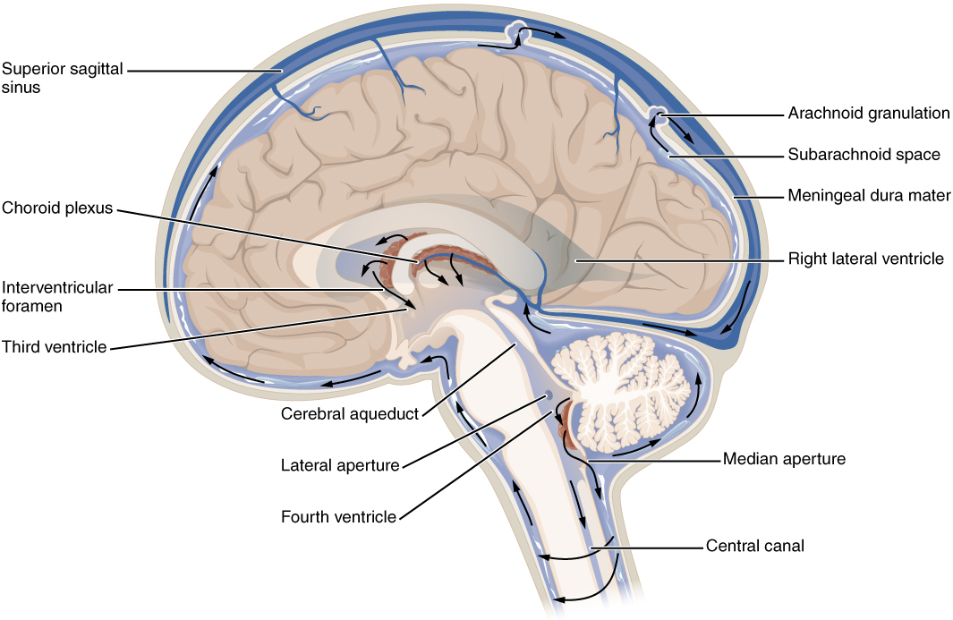
研究方法
n = 236 subjects with amyloid-β pathology.
from the Swedish BioFINDER-2 study.
Only participants with CSF biomarker evidence of cerebral amyloidosis (abnormal amyloidβ42/40 ratio) were included in the study cohort.
amyloid-β pathology (236)
cognitively unimpaired with amyloid-b-positive (78)
cognitively impaired (158) | mild cognitive impairment (77)
 | Alzheimer’s disease dementia (81)

Slide 9
研究方法
MRI protocol
Susceptibility weighting：multi-gradient echo pulse sequence；echo times = 5.00, 8.80, 12.60, 16.40 and 20.20 ms；voxel size =0.8 x 0.8 x 1.4 mm³
MPRAGE：voxel size =1 x 1 x 1 mm³
PET protocol
18F-RO-948示踪剂
FreeSurfer parcellation in anatomical MRI space >> co-registered, and time-averaged PET images >> regional uptake values >> globally normalized to the mean uptake in an inferior cerebellar grey matter (reference) region
Notes:
示踪剂标准化摄取值比

Slide 10
研究方法
QSM reconstruction：QSMbox (https://gitlab.com/acostaj/ QSMbox)
MSDI << nonlinear Morphology-Enabled Dipole Inversion (nMEDI)
其他工具包：
https://github.com/mathieuboudreau/qsm-tools/blob/master/README.md
https://www.emtphub.org/magnetic-software-packages/
QSM post-processing
a study-specific template was created：using radio-frequency bias corrected MPRAGE images from 125 pseudo-randomly selected participants including both healthy controls and neurodegenerative disease patients
a maximum of 90 iterations at the coarsest level, 30 at the next coarsest, and 90 at full resolution; template update step size was set to 0.1 mm. Four rigid-then-affine iterations were followed by six full runs of the above nonlinear multiresolution routine to ensure stable convergence. (Acosta-Cabronero et al. J Neurosci 2016;36:364–374)
Notes:
For template creation, radio-frequency bias corrected MPRAGE images were spatially normalized using the ‘Greedy-SyN’ approach in ANTs v2.1 with a maximum of 90 x 30 x 30 multi-resolution iterations and template-update step size set to 0.1 mm. Rigid plus-affine initial alignment was followed by six full runs of the above routine.

Slide 11
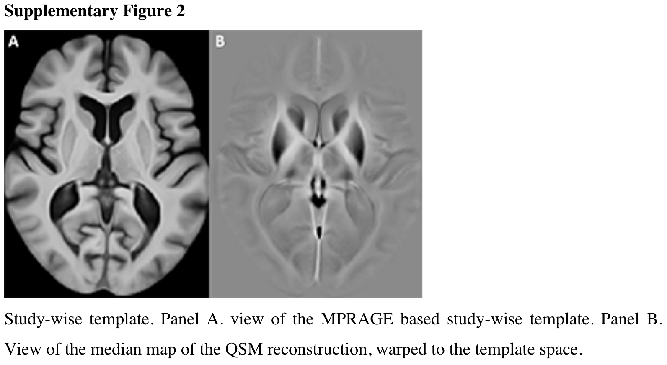
研究方法
QSM post-processing
bias-corrected T2*-weighted magnitude images >> rigidly co-registered >> corresponding MPRAGE volume
MPRAGE images >> Template space (ANTs).
QSM data >> Template space (the above transformations and third-order b-spline interpolation)

Slide 12
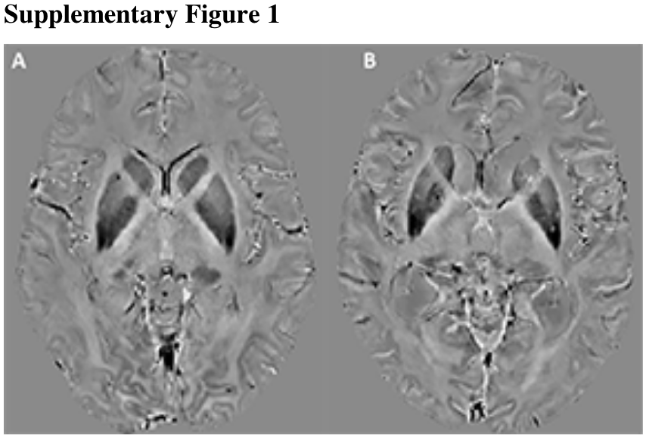
研究方法
QSM post-processing
To avoid making assumptions about areas being spared in patients, the main QSM results are shown with zero-centred data零均值化：x' = x – μ
Results with QSM values referenced to a deep prefrontal white matter region
利用 QSM 技术测定的组织磁化率值是相对值而不是绝对值，因此需选定一个合适参考区域来计算磁化率

Slide 13
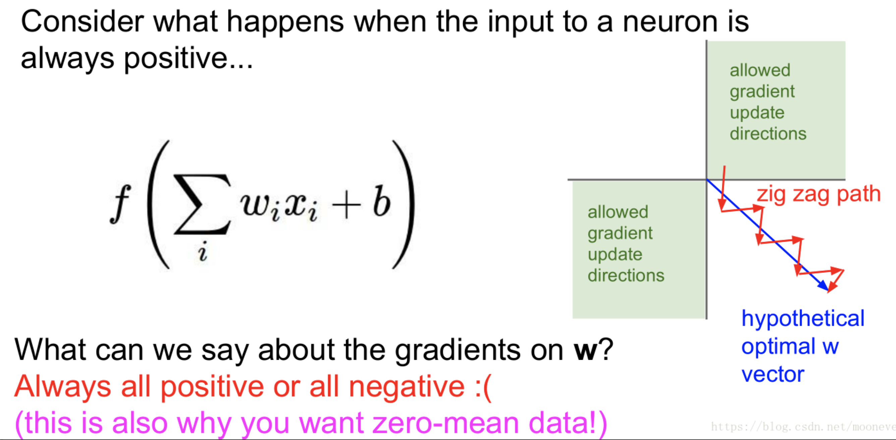
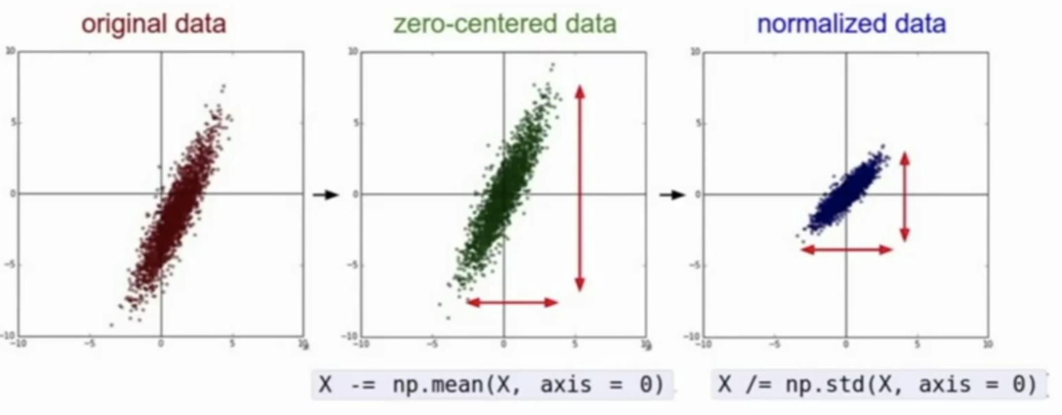
研究方法
zero-centred data零均值化：x‘ = x – μ，指变量减去它的均值。其实就是一个平移的过程，平移后所有数据的中心是（0，0）
可能图像分析采用此方法较多：在深度学习中，一般我们会把喂给网络模型的训练图片进行预处理，使用最多的方法就是零均值化(zero-mean) 中心化，即使像素值范围变为[-128,127]，以0为中心
在深度学习中的作用：为了在反向传播中加快网络中每一层权重参数的收敛。假设图中蓝色箭头方向理想最优w向量，当x全为正或者全为负时，每次返回的梯度都只会沿着一个方向发生变化，即梯度变化的方向就会向图中红色箭头所示，一会向上太多，一会向下太多。这样就会使得权重收敛效率很低。但当x正负数量“差不多”时，就能对梯度变化方向进行“修正”，使其接近上图中蓝色箭头的方向，加速了权重的收敛

Slide 14
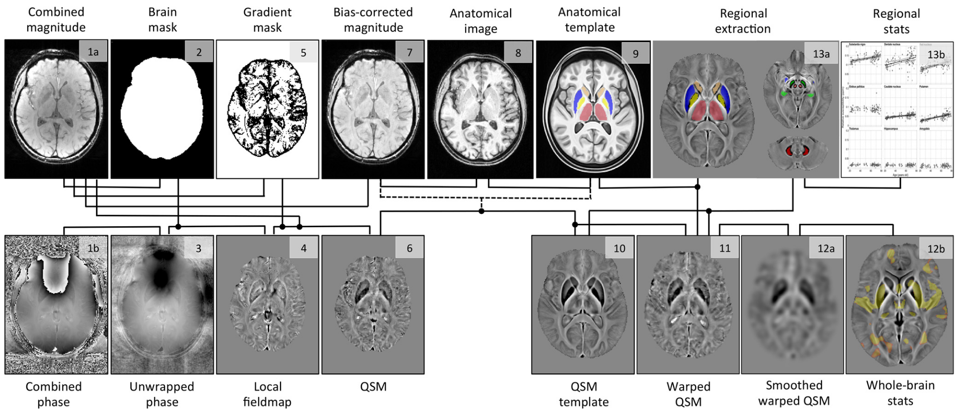
研究方法
Combind magnitude
>> Brain mask
>> Gradient mask
>> Bias-corrected magnitude
Combined phase >> Unwrapped phase + Brain mask >> Local fieldmap + Combined magnitude >> QSM
Anatomical image >> Anatomical template (ANTs); Bias-corrected magnitude >> affine coregistered to Anatomical image
QSM >> QSM template (An average template was then calculated from all warped QSMs) >> Warped QSM >> Smoothed Warped QSM >> Whole-Brain stats >> MNI152 (QSM template and study results were warped to MNI152 space using b-spline and trilinear interpolation, respectively)
(Acosta-Cabronero et al. J Neurosci 2016;36:364–374)
Notes:
B样条插值和三线插值法

Slide 15
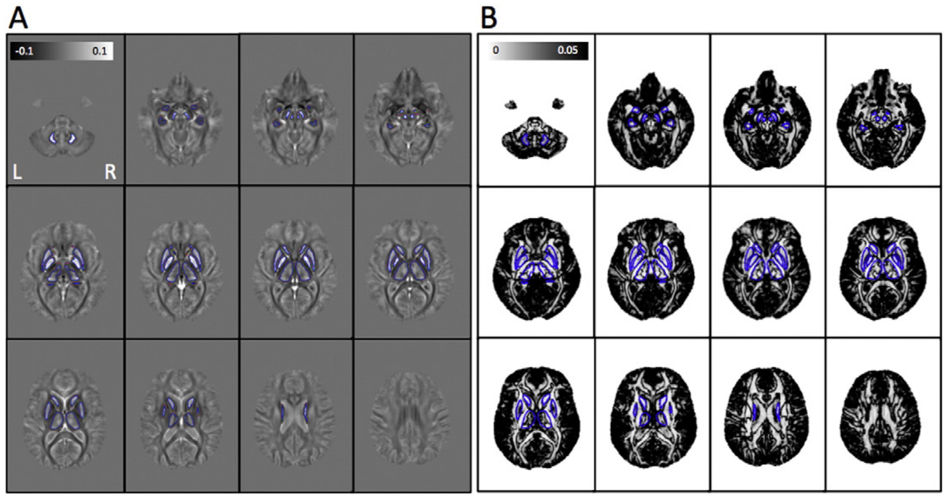
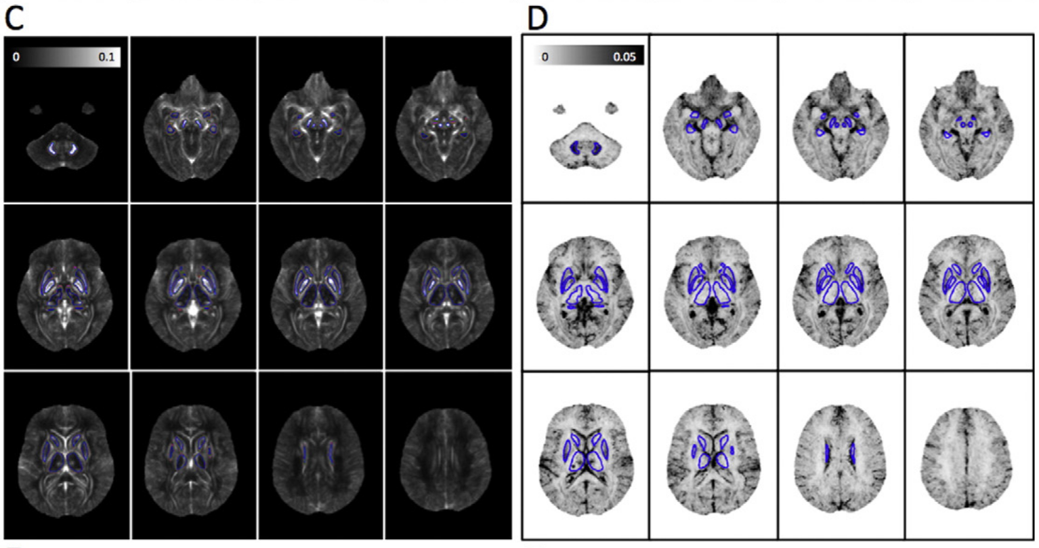
研究方法
(A, B) signed QSM >> ROI analysis
(C, D) absolute QSM (|QSM|) >> whole-brain
Code：fslmaths QSM.nii.gz –abs QSM_abs.nii.gz
-abs : absolute value
The absolute value was taken to QSM to improve statistical conditioning for whole-brain analysis (Betts et al., 2016) and to ameliorate the spurious impact of blooming effects
(Betts et al. Neuroimage 2016;138:43–63)

Slide 16
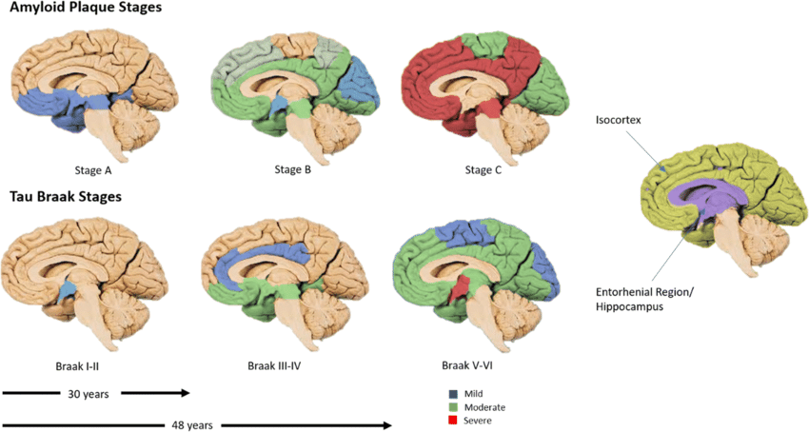
研究方法
Voxel-wise grey matter QSM cluster-enhanced analysis
Absolute susceptibility maps
高斯核平滑，标准差为3mm
additional compensation for brain-boundary effects
降采样到2mm³
协变量感兴趣区covariate of interest (tau-PET ) ：反映Braak stages I-IV相对应的颞区，双侧的内嗅皮层，梭状皮层，下、中颞皮层
SPM12组织分割-灰质 >>基于体素的回归分析
使用 FSL-randomise 进行 TFCE 校正（10000 permutations）
使用 FWE 校正P值：P<0.01
https://www.wikiwand.com/en/Braak_staging
Notes:
Braak分期V/VI是tau神经纤维缠结的病理分期量表
Staging in Alzheimer's disease was described by Braak in 1991.^{[8]} Braak stages I and II are used when neurofibrillary tangle involvement is confined mainly to the transentorhinal region横嗅of the brain, stages III and IV when there is also involvement of limbic regions such as the hippocampus, and V and VI when there is extensive neocortical involvement

Slide 17
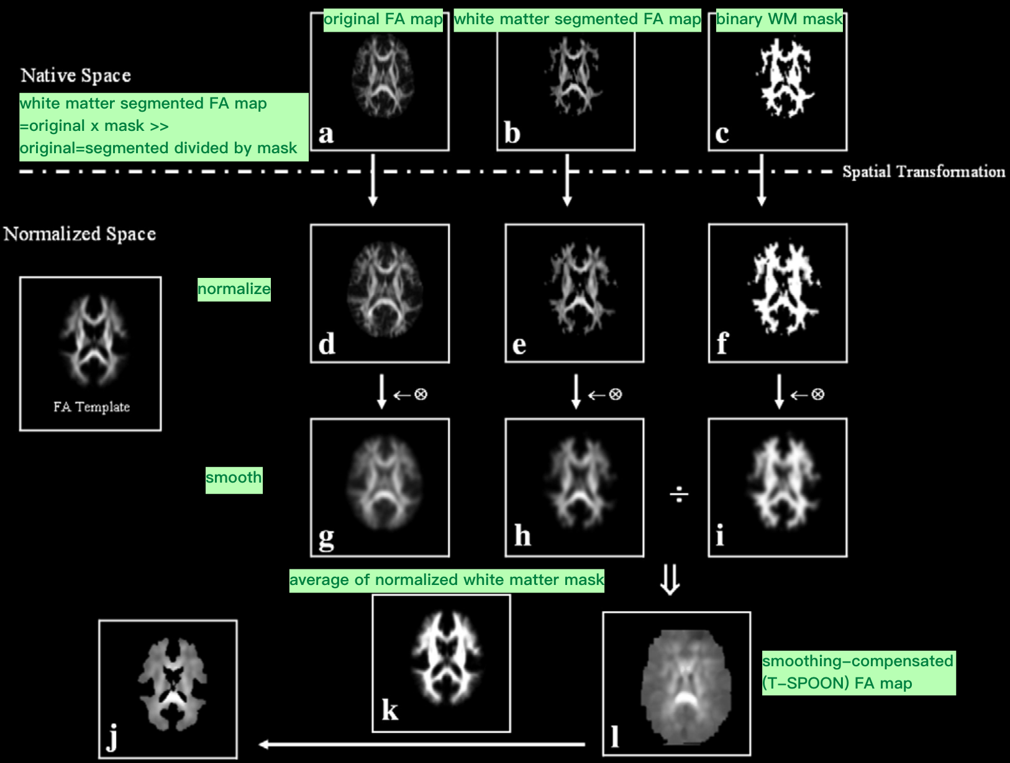
研究方法
(i) GM and WM tissue segments were inferred from native T1weighted images using the “unified segmentation” model built into SPM12 with default settings;
(ii) both segments were added together resulting in a brain parenchymal probability segment, which was warped to the studywise space, thresholded at Prob >0.5 and binarised;
(iii) warped QSM maps were subsequently brain-masked;
(iv) both brain masks and quantitative maps were smoothed with a 3D-Gaussian kernel;
(v) smoothed QSM volumes were (element-wise) divided by their corresponding smoothed brain mask resulting in parenchyma-specific, smoothing-compensated maps.
Since the smoothed WM masks have the same blurring as the normalized and smoothed DTI maps, the division will make the smoothed data have values more similar to the original data set.
(Betts et al. Neuroimage 2016;138:43–63)

Slide 18
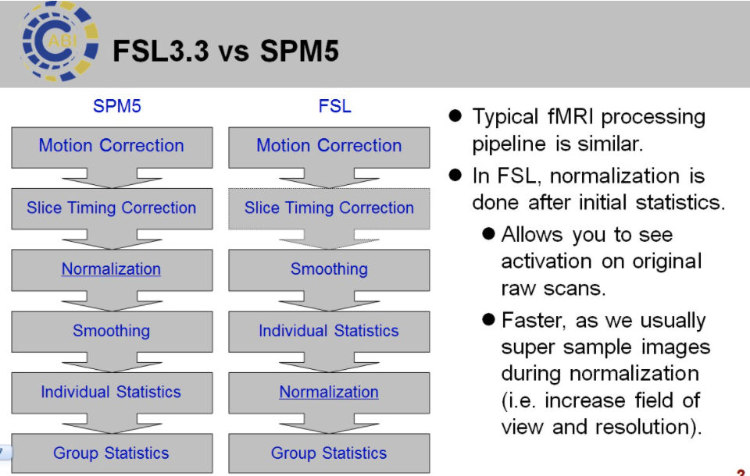
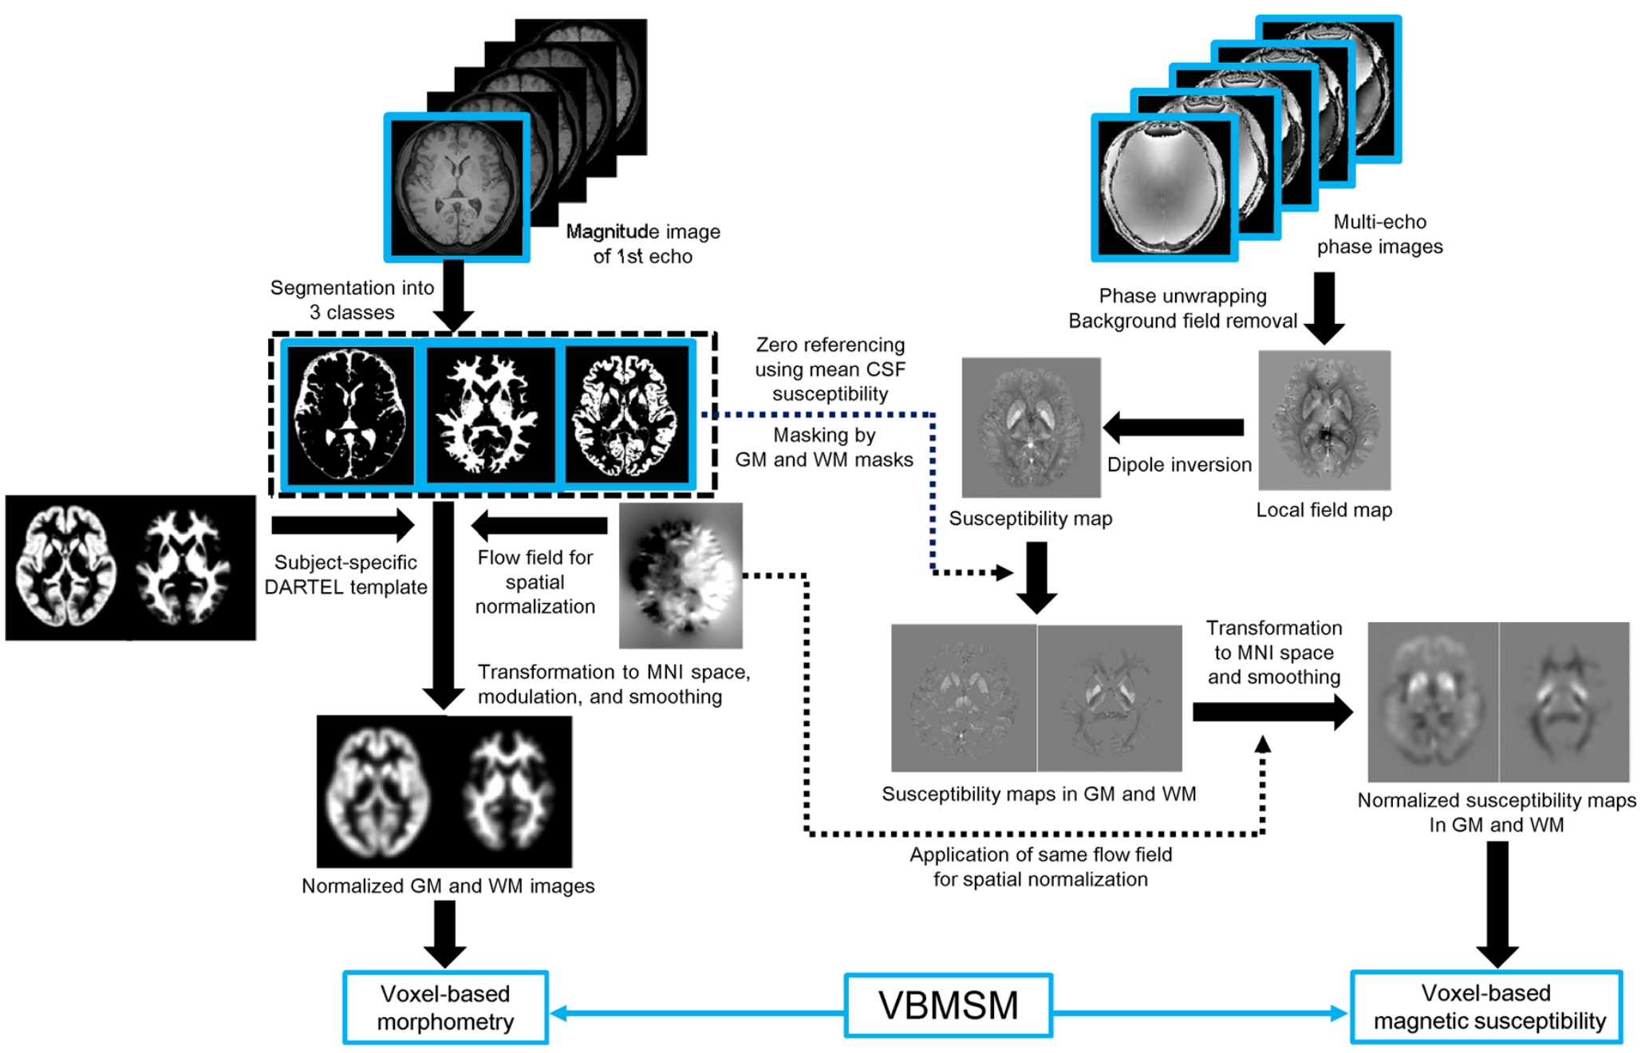
研究方法
本文中是平滑 >> compensation >> mask分割 >> 个体统计学结果 >> 标准化
也有文献：Mask分割 >> 平滑 >> 标准化 >> 统计

Slide 19
研究方法
Regional analysis
平均signed QSM值、tau-PET摄取值：68 bilateral cortical regions of the Desikan-Killiany-Tourville atlas （FreeSurfer v6）
补充：as it enables discrimination between paramagnetic and diamagnetic susceptibility sources
对分割脑区做相关分析得到皮尔森相关系数；相应P值做FDR校正：P<0.05
多元回归分析：颞下回（ITG），平均QSM值、平均tau-PET摄取值、平均皮质厚度、认知状况
以65岁（早发型AD型痴呆发病年龄的上限）为cut-off分组：年轻组vs老年组
中介分析：QSM值、tau-PET摄取值、皮质厚度（中介效应- bootstrapping [10000 samples]）；模型纳入了认知、年龄、性别为协变量

Slide 20
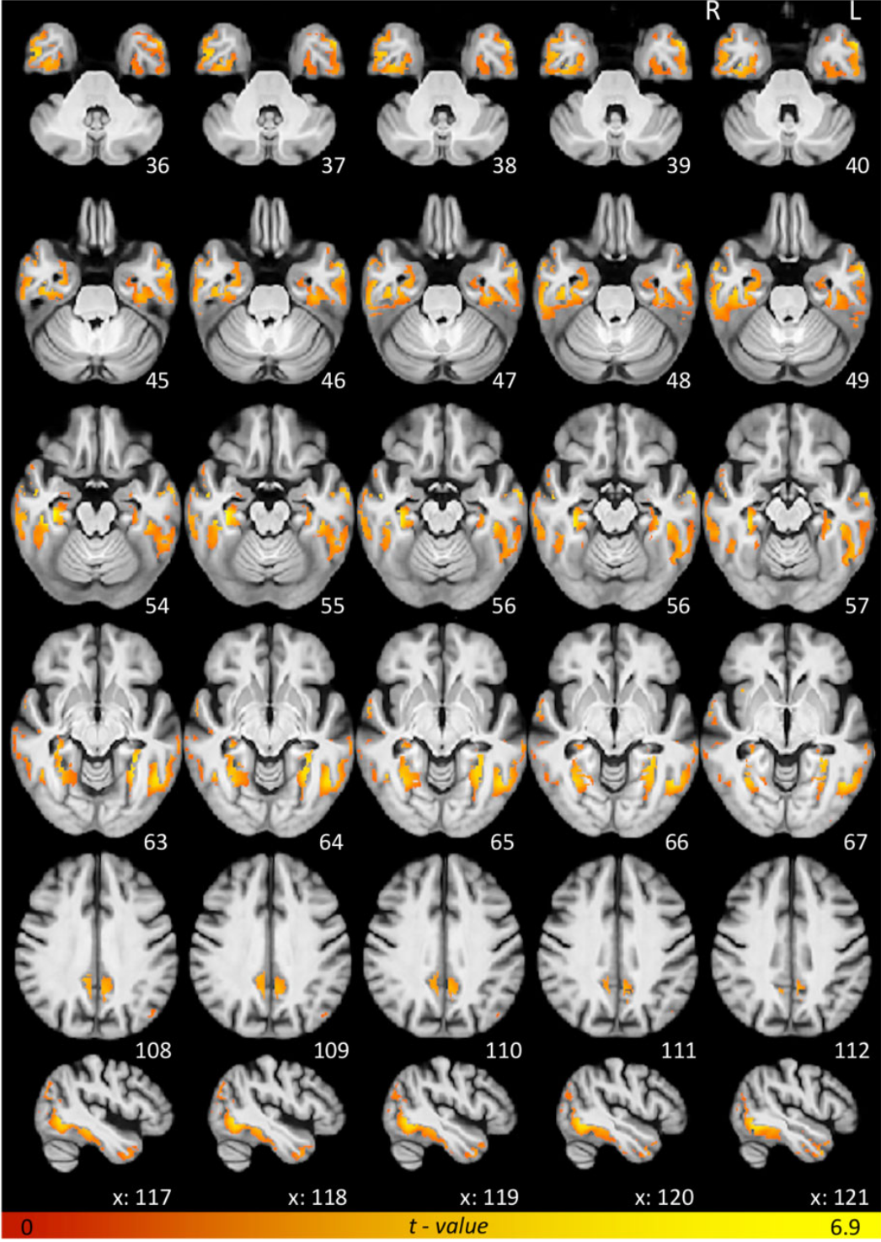
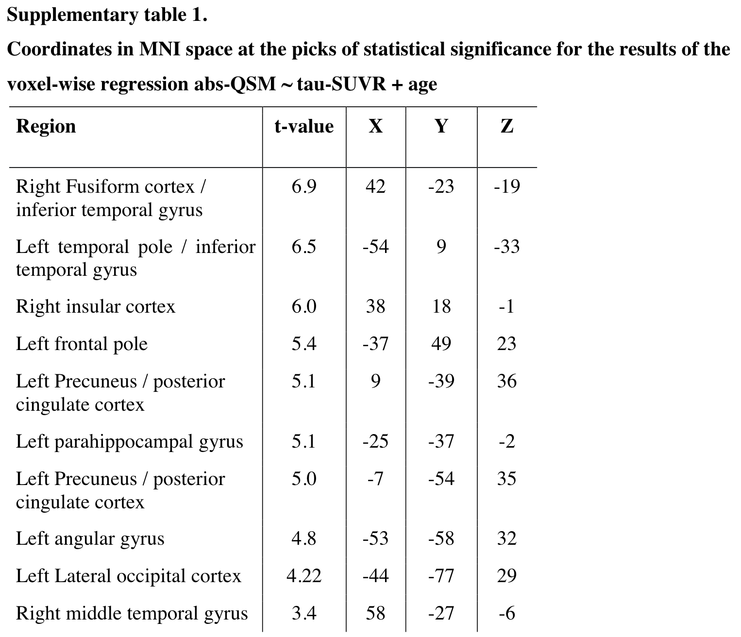
研究结果
absolute-QSM ~ tau-SUVR + age
结果表明，颞叶区内tau-PET标准化摄取值比主要与颞中、下回、梭状回、海马旁回、颞极内的绝对磁化率值上升有统计学关系
此外，顶叶区域尤其缘上回，楔前叶，扣带回后部，外侧枕叶，额叶区域如额中叶和岛叶皮质也与颞叶 tau-PET示踪剂摄取相关
Notes:
For visualization purposes the results have been warped to MNI space (Montreal neurological institute template) using ANTs routines and displayed over the study-wise anatomical template.

Slide 21
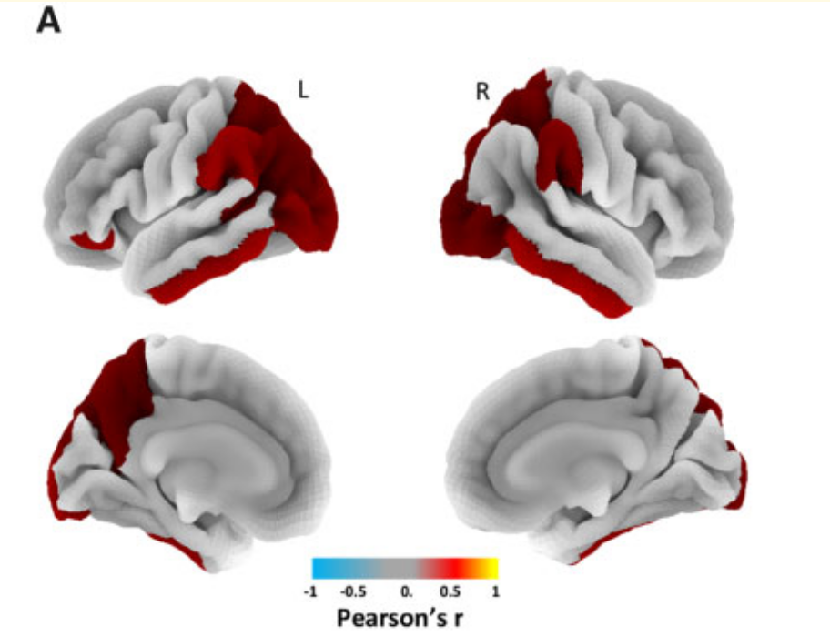
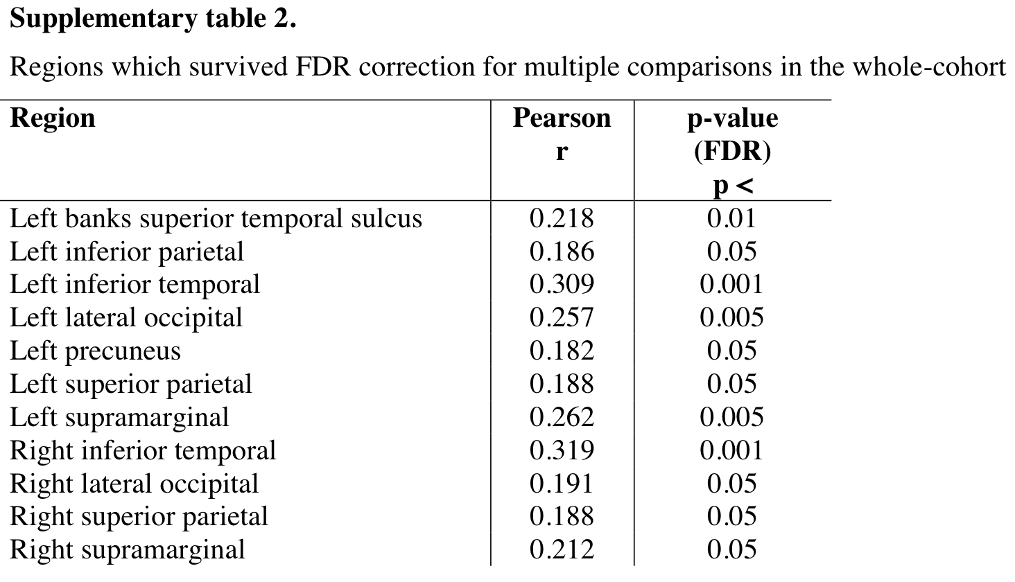
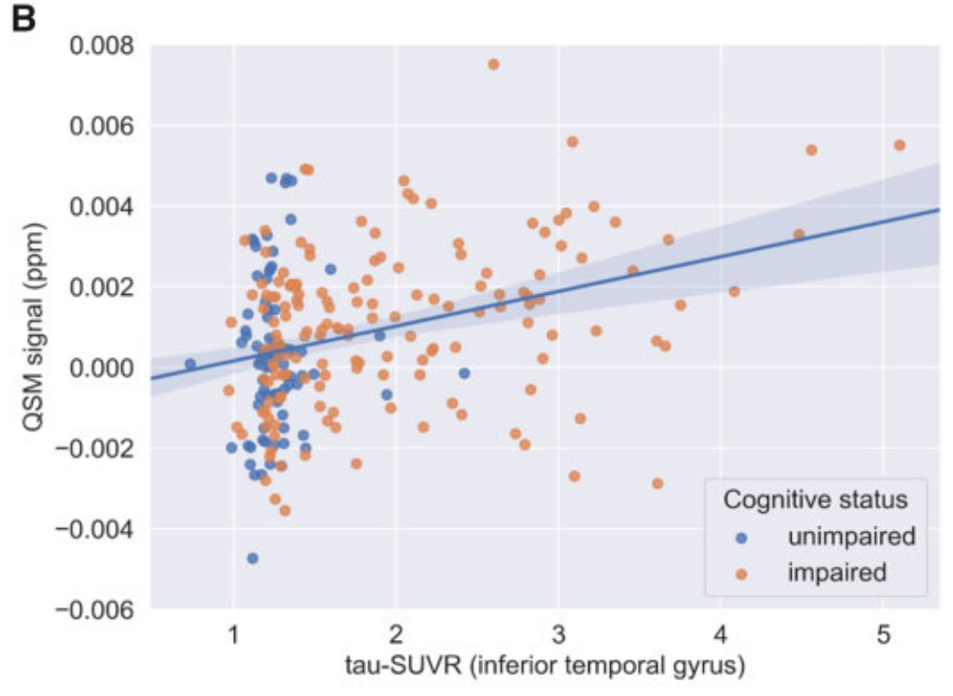
研究结果
感兴趣区分析证实，全脑分析中关于磁化率绝对值正相关确实由QSM（±）的局部增加引起，与铁沉积的情况一致
颞下回（ITG）表现出了最强的相关性[left ITG: r =0.31, P <0.001 FDR; right ITG: r = 0.32, P <0.001 FDR]
ITG的进一步分析（各半球平均，并考虑到年龄和性别可能产生的混杂影响，并将认知状态作为一个协变量）证实了两值之间的正相关

Slide 22
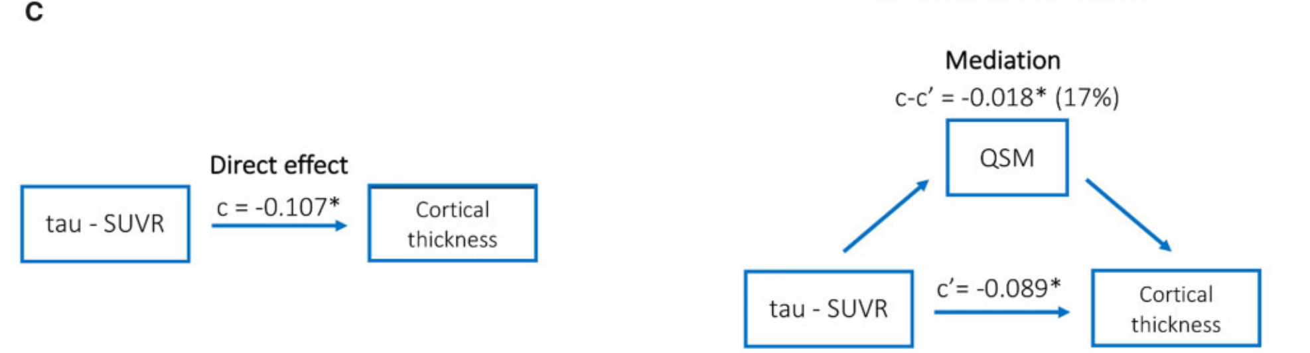
研究结果
中介效应分析
c-c'是QSM的调解效应[b=-0.018，P <0.001，CI：-0.03 to -0.01]
QSM可以解释17%（bratio）的tau-PET示踪剂摄取对皮质厚度的影响

Slide 23
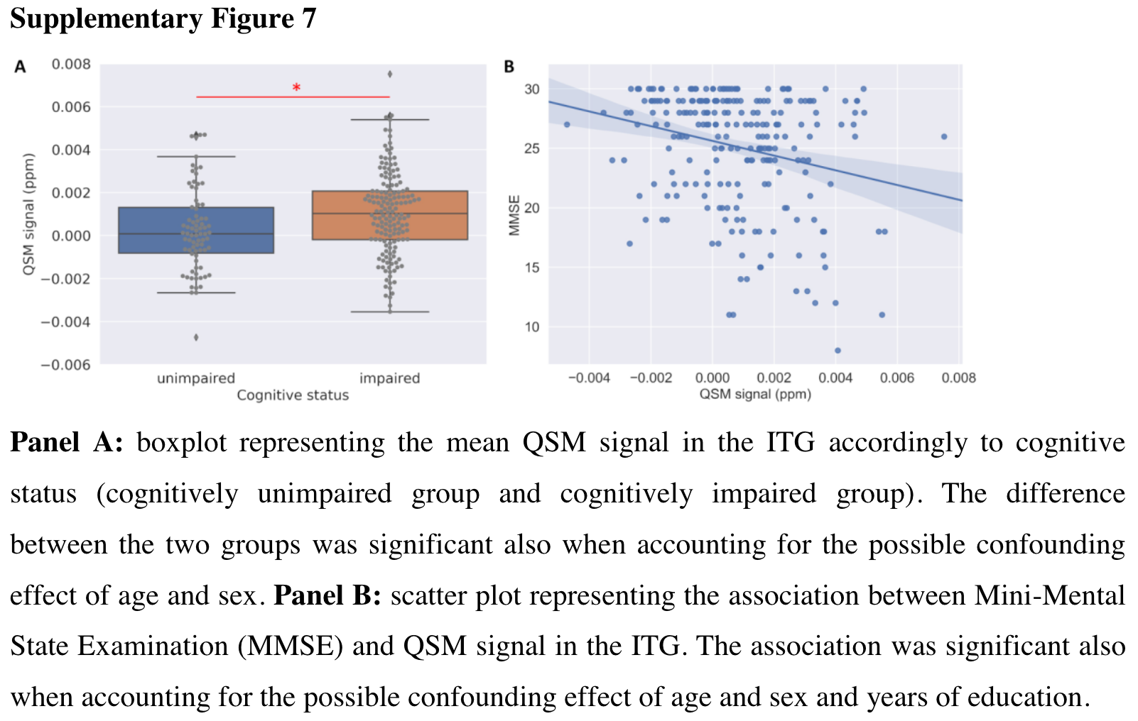
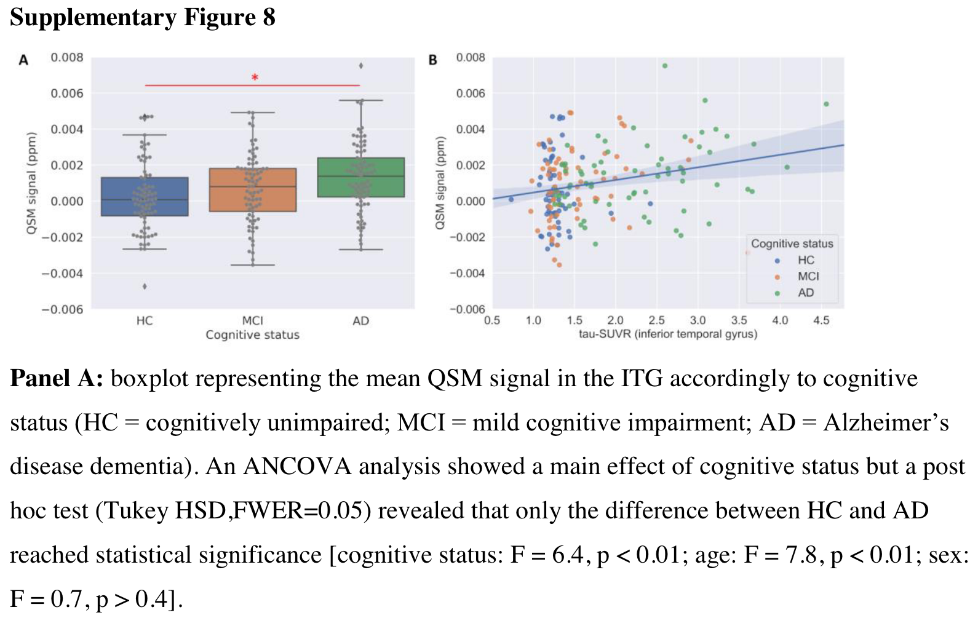
研究结果
ITG区
方差分析：磁化率值在认知组间的差异
回归模型：年龄、性别和教育水平（年）作为干扰协变量 >> QSM值与MMSE评分呈负相关

Slide 24
研究结果
磁化率值特异性地介导了tau-PET示踪剂标准化摄取值比和皮质萎缩之间的关系
铁沉积对AD疾病过程的作用
定量磁化率值和tau-PET示踪剂标准化摄取值比之间的关系在年轻受试者中更强（年龄≤65岁）

